Slide 1

Accessible digital banking for senior people in HK

Slide 2
Research questions – What is the expected takeaway from the research
1
2
3
4
Patterns in elderly banking behaviours
What are the factors contributing to senior people’s reluctance towards digital banking?
What types of barriers (physical, knowledge, psychological) is more salient in preventing digital banking?
How to enhance banking accessibility for aging people?
Notes:
List out our questions or observations on things to get right

Slide 3
Quantitative Approach
30+ survey questions
Divided into
Recipient concern & Demographic questions
Banking Behavior Question
Banking choice (Branch visiting, Phone Banking, ATM and Digital)
Frequency of Visiting
Transaction types
Reason of choosing
3) Barrier Questions
Physical Barrier
Trust/Phycological Barrier
Knowledge Barrier
4) Advice
Tools
Features
Function

Slide 4
Presentation Name| Demographic information
Age Group | Count (N=151) | Percentage (%)
Young-old (60 - 69) | 67 | 44.4
Old-old (70 - 80) | 72 | 47.4
Oldest-old (80 & 80+) | 12 | 7.95
Gender | Count (N=151) | Percentage (%)
Male | 70 | 46.4
Female | 80 | 53.0
Not disclosed | 1 | 0.662

Slide 5
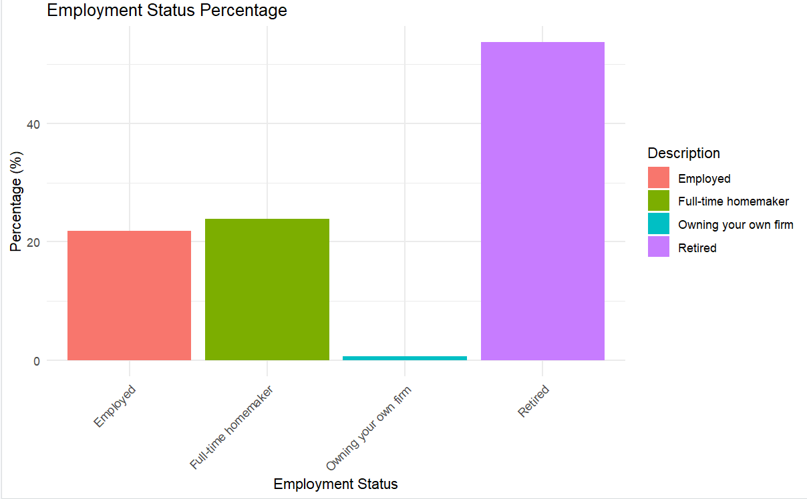
Employment Status

Slide 6
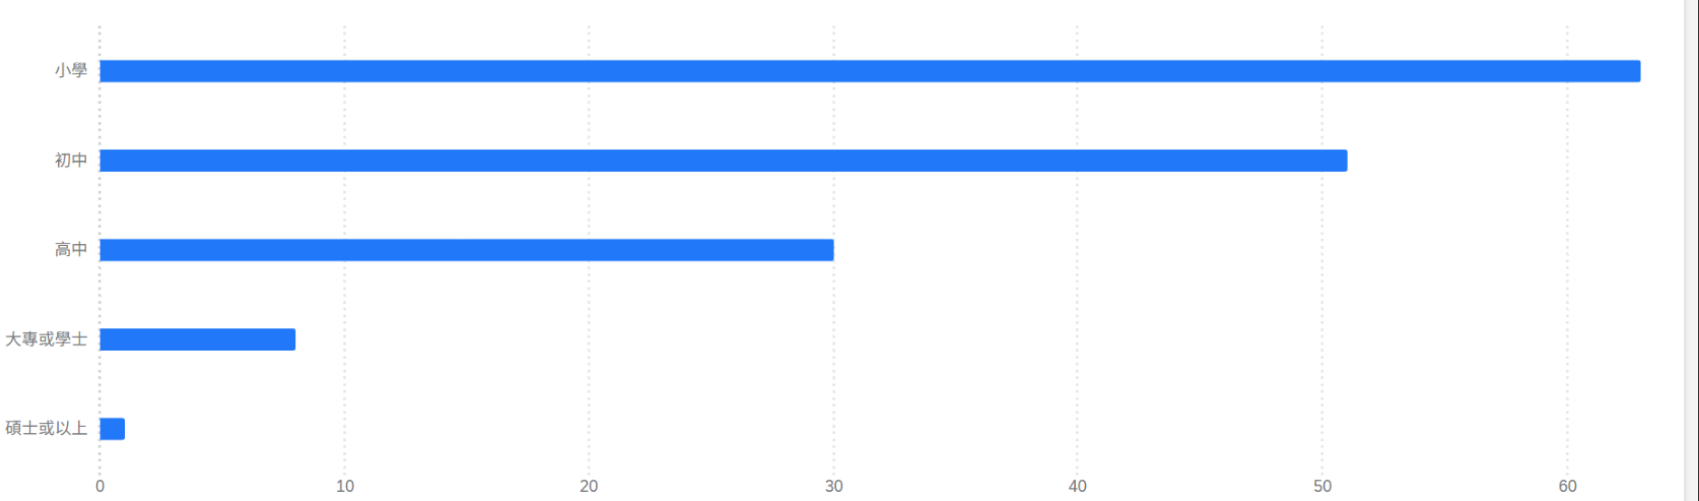
Education Distribution
Primary
Middle School
High School
Bachelor
Doctorate

Slide 7
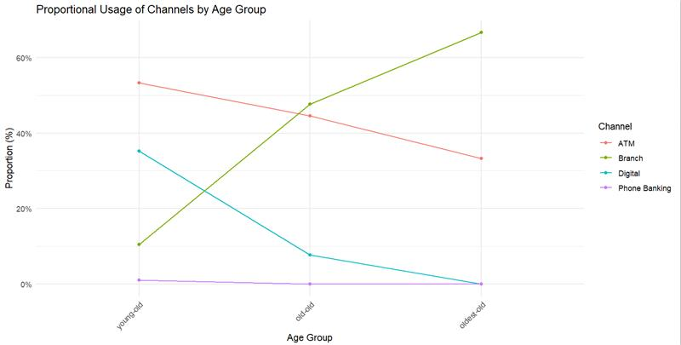
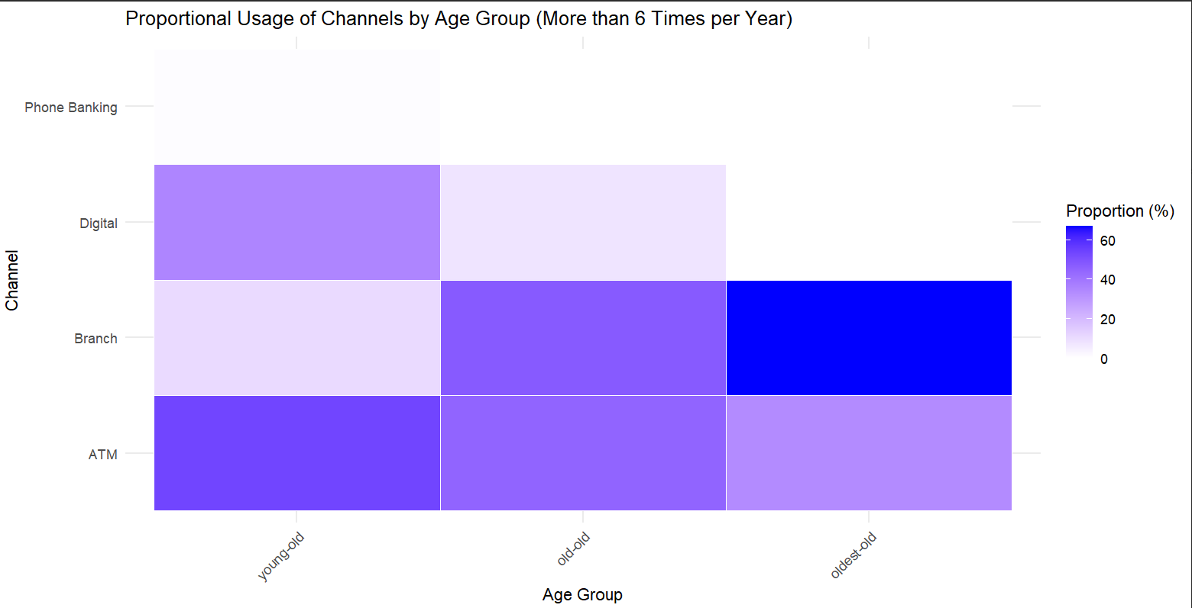
Banking Behaviors

Slide 8
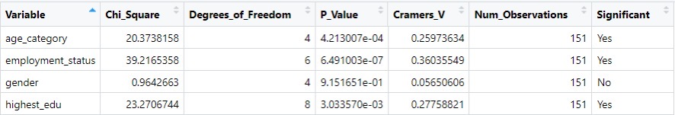
Feature Importance Testing – Banking Behavior
How different variables contribute to banking channels
Branch Visiting
Digital Banking

Slide 9
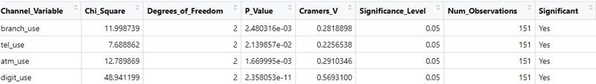
Age Impact on Selection on Transactions Frequency
Categorized age into age_group e.g. young-old, old-old, eldest-old
Frequency of usage is categorized to 0 times, 1-5 times and 6 or more times

Slide 10
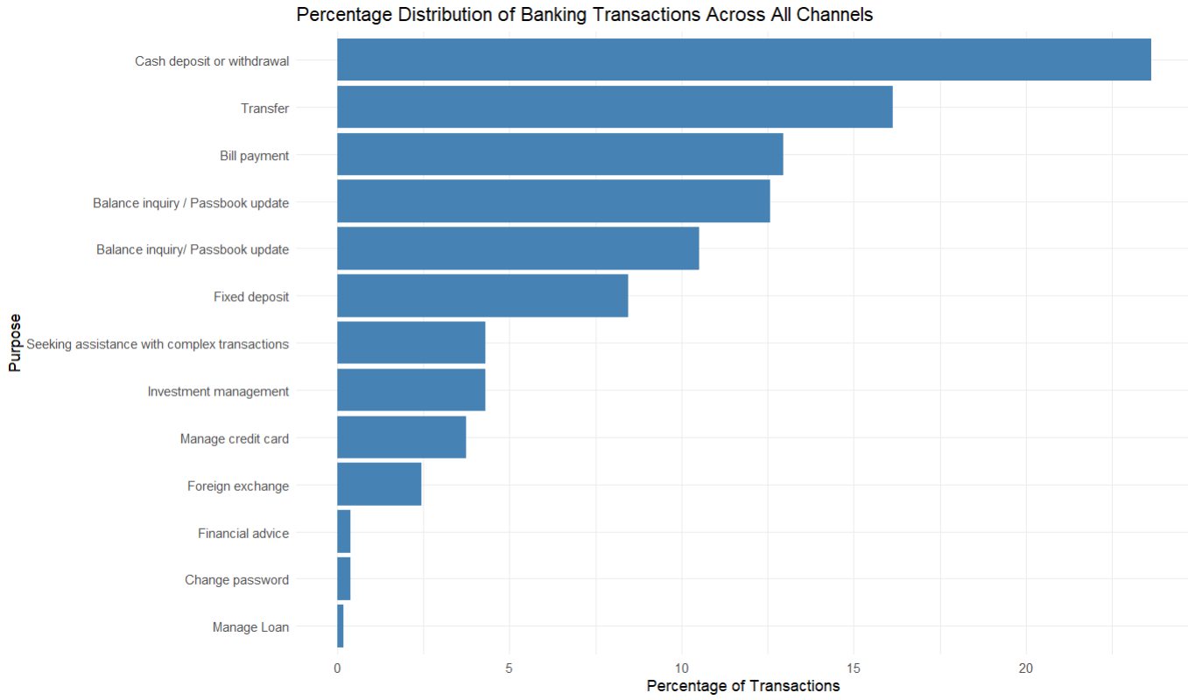

Slide 11
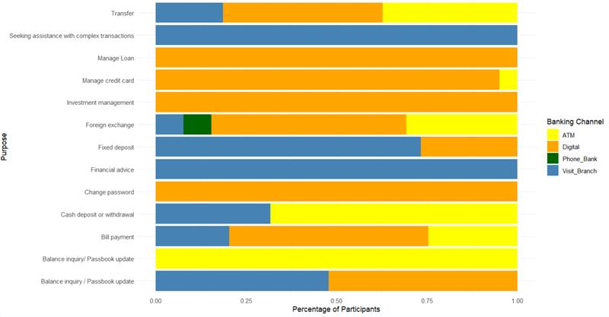
Types of Transactions Across All Platform

Slide 12
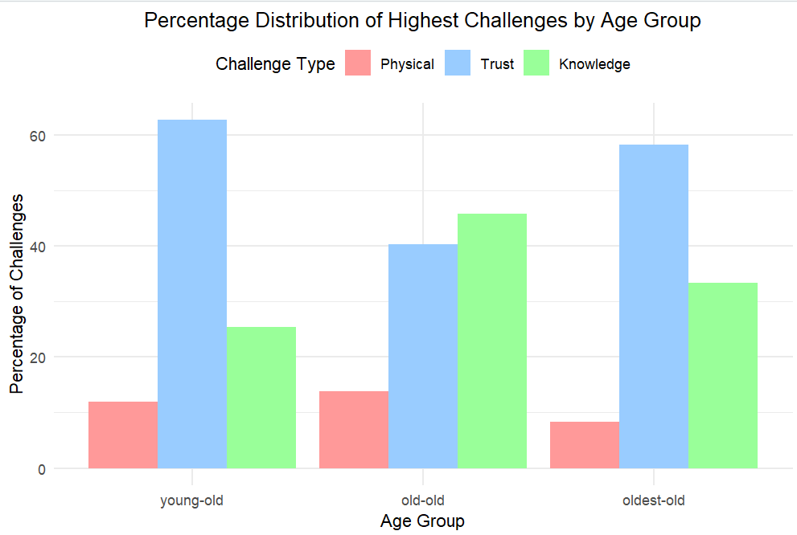
Barrier

Slide 13
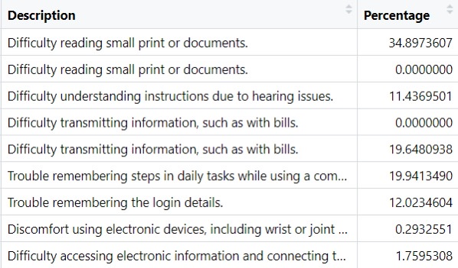
Physical Barriers

Slide 14
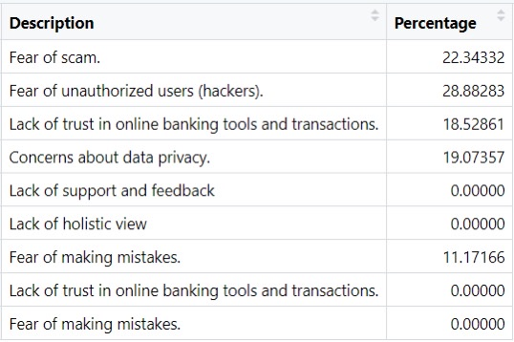

Slide 15
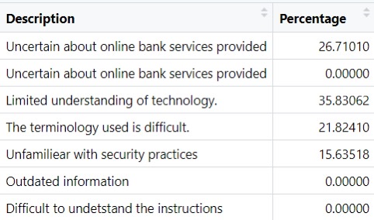

Slide 16
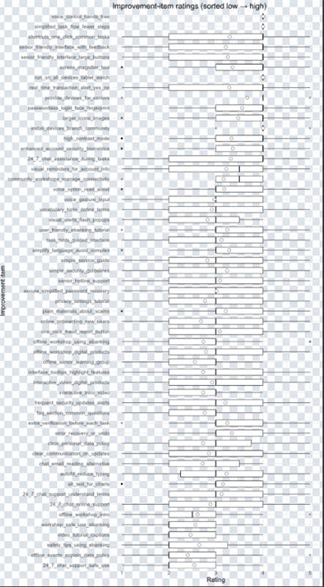
Chatbot
Voice options to read textual information
Error recovery
Auto fill in

Slide 17
Next Steps
Continuously discovering the pattern in the surveying data
Age vs Barriers
Education vs Channel selection
Qualitative Analysis
Conduct interview with the branch working staff
Focus on those have more than 3 years of working age
Have experiences in dealing with elder customers

